Slide 1
IN319: Unix Programming (2017)

Slide 2
Introduction
Time & Location
Theory : two times a week
Lab : two times a week
Hi-Tech, #
Instructor
JuHong Lee, Database/DataMining Lab
Hi-Tech, #1404
Tel. 860-7453, juhong@inha.ac.kr

Slide 3
Prerequisites
C/C++ programming skills
Cheating
What is cheating?
Sharing code: either by copying, retyping, looking at, or supplying a copy of a file.
What is NOT cheating?
Helping others use systems or tools.
Helping others with high-level design issues.
Helping others debug their code.
Penalty for cheating:
Point about that HW is 0

Slide 4
Lectures
Topics
File Access Primitives, Standard I/O library
Files in Multi-user environment Files with multiple names
Obtaining file information Programming with directories
Unix File systems Unix device files
Creating processes, Running processes, Terminating with exit
Synchronizing Processes
Process attributes
Signal Handling,
Interprocess Communication using pipes
Record Locking
Message passing, Semaphores
Shared memory
Socket programming

Slide 5
Evaluation
Home works : 20%
Exams(Midterm, Final) : 70%(35%,35%)
Class participation : 10%

Slide 6
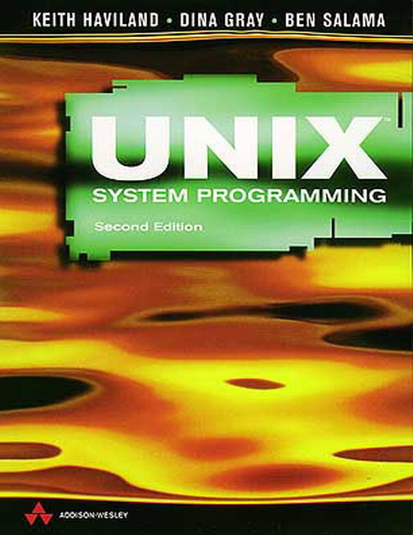
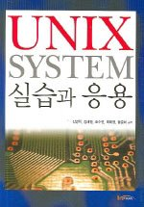
Text Book
UNIX SYSTEM PROGRAMMING, Second Edition
KEITH HAVILAND, DINA GRAY, BEN SALAMA
ADDISON WESELY
UNIX SYSTEM 실습과 응용
김영학, 김태형, 조수현, 최태형, 황준하
한티미디어

Slide 7
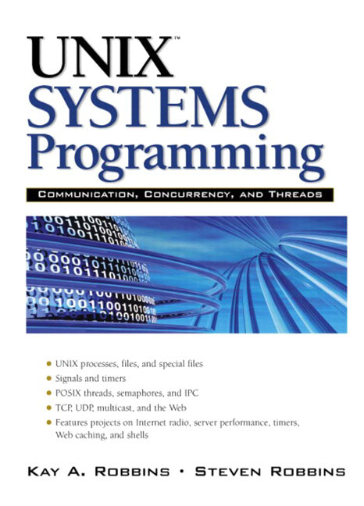
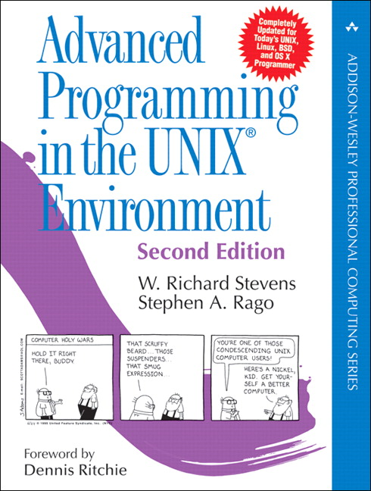
Reference
UNIX Systems Programming Communication, Concurrency and Threads 2nd Edition
Kay Robbins, Steve Robbins
PRENTIC HALL
Advanced Programming in the UNIX(R) Environment (2nd Edition)
W. Richard Stevens, Stephen A. Rago
Addison-Wesley

